Slide 1
26/04/2022
Title: Review of Expressions
Aim:
be able to describe like terms
Expand and simply expression
Plan:
Refresh terminology
Refresh double signs
Collect like terms
Expand brackets
Need whiteboards

Slide 2
The word is
Pronumeral
A letter or symbol used in place of a number
Pronumerals represent numbers, so they MUST follow the same rules as numbers.

Slide 3
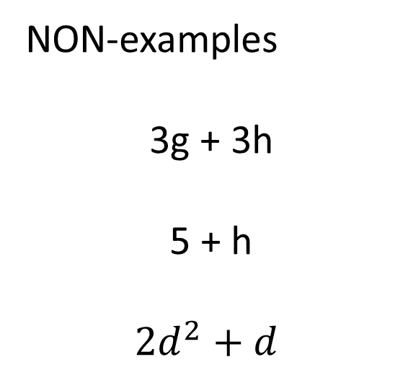
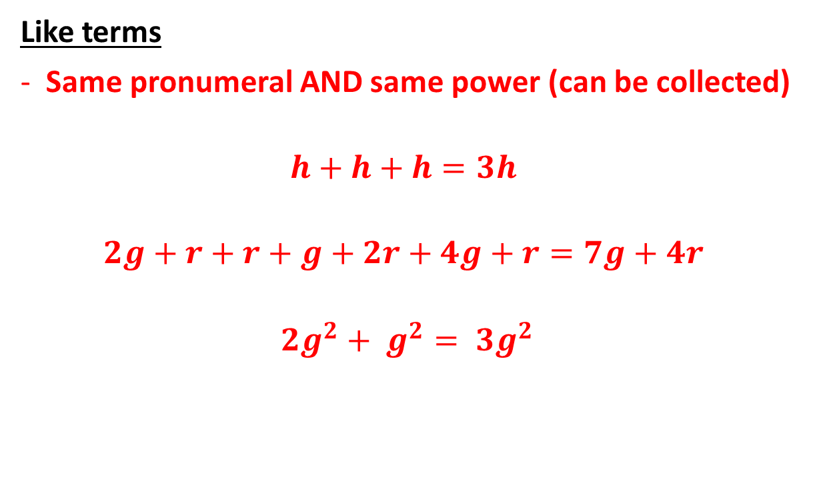
Terminology
Like terms
Same pronumeral AND same power (can be collected)
$$h+h+h=3h$$
$$2g+r+r+g+2r+4g+r=7g+4r$$
$${2g}^{2}+ g^{2}= {3g}^{2}$$
NON-examples
3g + 3h
5 + h
$${2d}^{2}+d$$

Slide 4
Like terms (I do)
4y + 5y =
8c + 4c – 3c =
7t + 4r + 2t – 2r =
8h + 4d + 9 + 2h=

Slide 5
Whiteboards
Simplify by collecting like terms
4d + d + 2d
5f + 2f – 5c
10f + 3f – 5f + 2d + 4d
4f + 8d – 4f – 8d

Slide 6
Double signs
Double signs:
Adding a negative number is the same as subtracting.
Subtracting a negative number is the same as adding.
7 – (-3) can be written as 7 + 3
12 + (-4) can be written as 12 – 4
-3 + (-2) can be written as -3 – 2

Slide 7
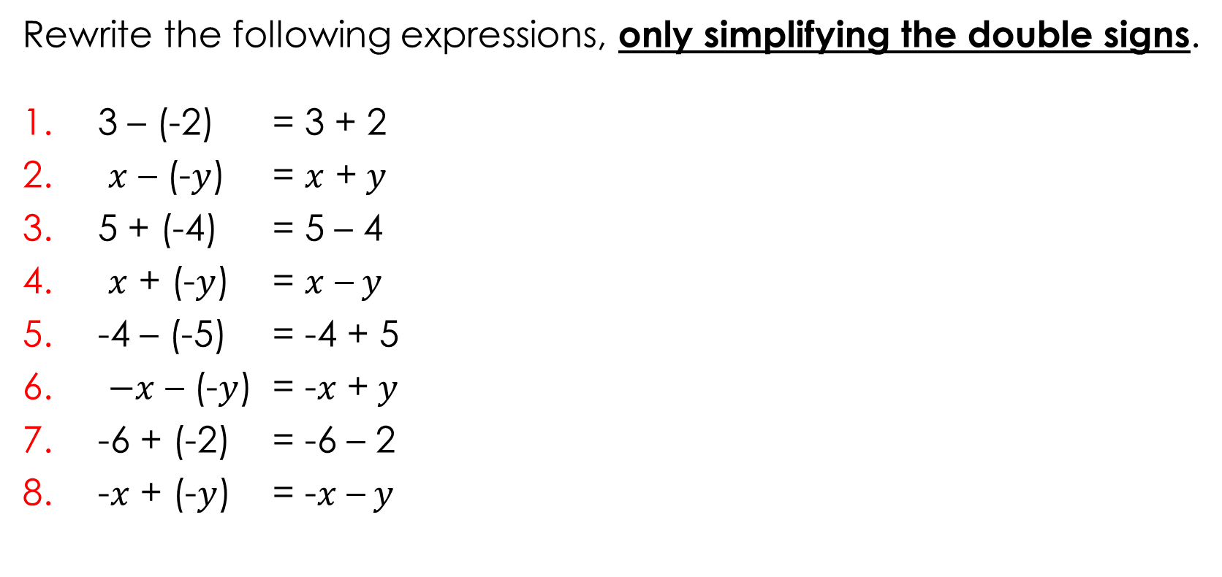
Daily review – Directed number.
Same signs add – different signs subtract
Rewrite the following expressions, only simplifying the double signs.
3 – (-2) = 3 + 2
$x$ – (-$y$) = $x$ +$y$
5 + (-4) = 5 – 4
$x$ + (-$y$) = $x$ –$y$
-4 – (-5) = -4 + 5
$−x$ – (-$y$) = -$x$ +$y$
-6 + (-2) = -6 – 2
-$x$ + (-$y$) = -$x$ –$y$

Slide 8
Whiteboards
4(2x + 4)
2(4f – 2)
3(2 – 3e)
10(2s +3)
x(x + 3)
4(2d + 4r – 3)

Slide 9
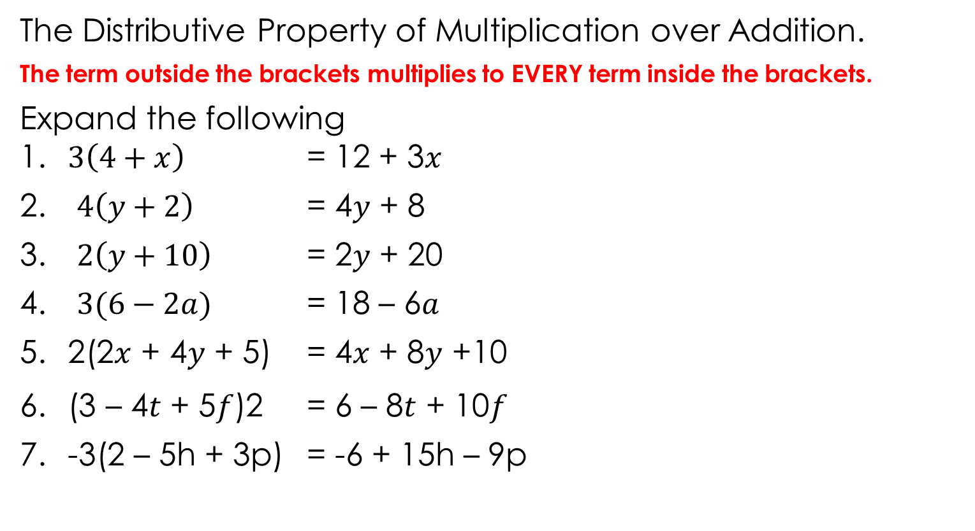
The Distributive Property of Multiplication over Addition.
The term outside the brackets multiplies to EVERY term inside the brackets.
Expand the following 1. $3\left(4+x\right)$ = 12 + 3$x$
$4\left(y+2\right)$ = 4$y$ + 8
$2\left(y+10\right)$ = 2$y$ + 20
$3(6−2a)$ = 18 – 6$a$
2(2$x$ + 4$y$ + 5) = 4$x$ + 8$y$ +10
(3 – 4$t$ + 5$f$)2 = 6 – 8$t$ + 10$f$
-3(2 – 5h + 3p) = -6 + 15h – 9p
Notes:
Student worksheet

Slide 10
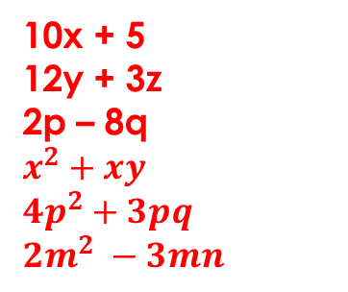

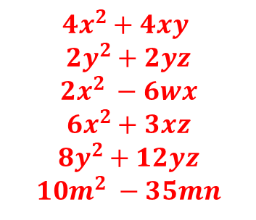
Expanding brackets practice
BRONZE
SILVER
GOLD
3 ( x + 4 )
5 ( y + 2 )
2 ( x − 6 )
x ( x + 8 )
y ( y + 3 )
n ( n − 5 )
5 ( 2x + 1 )
3 ( 4y + z )
2 ( p − 4q )
x ( x + y )
p ( 4p + 3q )
m ( 2m − 3n )
4x ( x + y )
2y ( y + z )
2x ( x − 3w )
3x ( 2x + z )
4y ( 2y + 3z )
5m ( 2m − 7n )
3x + 12
5y + 10
2x – 12
$$x^{2}+8x$$
$$y^{2}+3y$$
$$n^{2} −5n$$
10x + 5
12y + 3z
2p – 8q
$$x^{2}+xy$$
$${4p}^{2}+3pq$$
$${2m}^{2} −3mn$$
$${4x}^{2}+4xy$$
$${2y}^{2}+2yz$$
$${2x}^{2} −6wx$$
$${6x}^{2}+3xz$$
$${8y}^{2}+12yz$$
$${10m}^{2} −35mn$$

